Slide 1

David M. Kroenke and David J. Auer Database Processing Fundamentals, Design, and Implementation
Chapter Twelve:
Big Data, Data Warehouses, and
Business Intelligence Systems

Slide 2
Chapter Objectives
To learn the basic concepts of Big Data, structured storage, and the MapReduce process
To learn the basic concepts of data warehouses and data marts
To learn the basic concepts of dimensional databases
To learn the basic concepts of business intelligence (BI) systems
To learn the basic concepts of OnLine Analytical Processing (OLAP) and data mining
To learn the basic concepts of distributed databases
To learn the basic concepts of virtual machines
To learn the basic concepts of cloud computing

Slide 3
Big Data
Big Data—the current term for the enormous datasets generated by Web applications such as search tools (for example, Google and Bing) and Web 2.0 social networks (for example, Facebook, LinkedIn, and Twitter).
Although these new and very visible Web applications are highlighting the problems of dealing with large datasets, these problems were already present in other areas, such as scientific research and business operations.

Slide 4
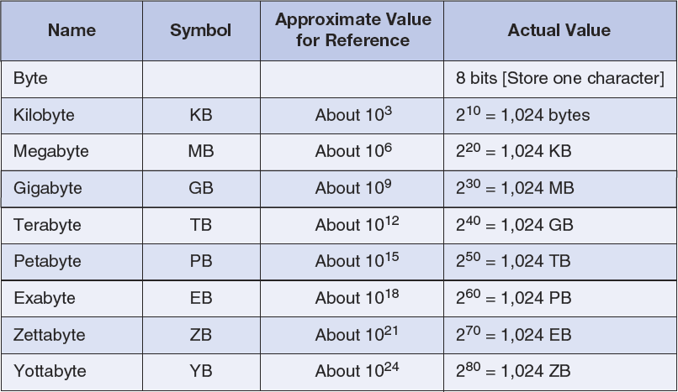
Storage Capacity Terms

Slide 5
Business Intelligence (BI) Systems
Business intelligence (BI) systems are information systems that assist managers and other professionals:
To analyze current and past activities.
To predict future events.
Two broad categories:
Reporting
Data mining

Slide 6
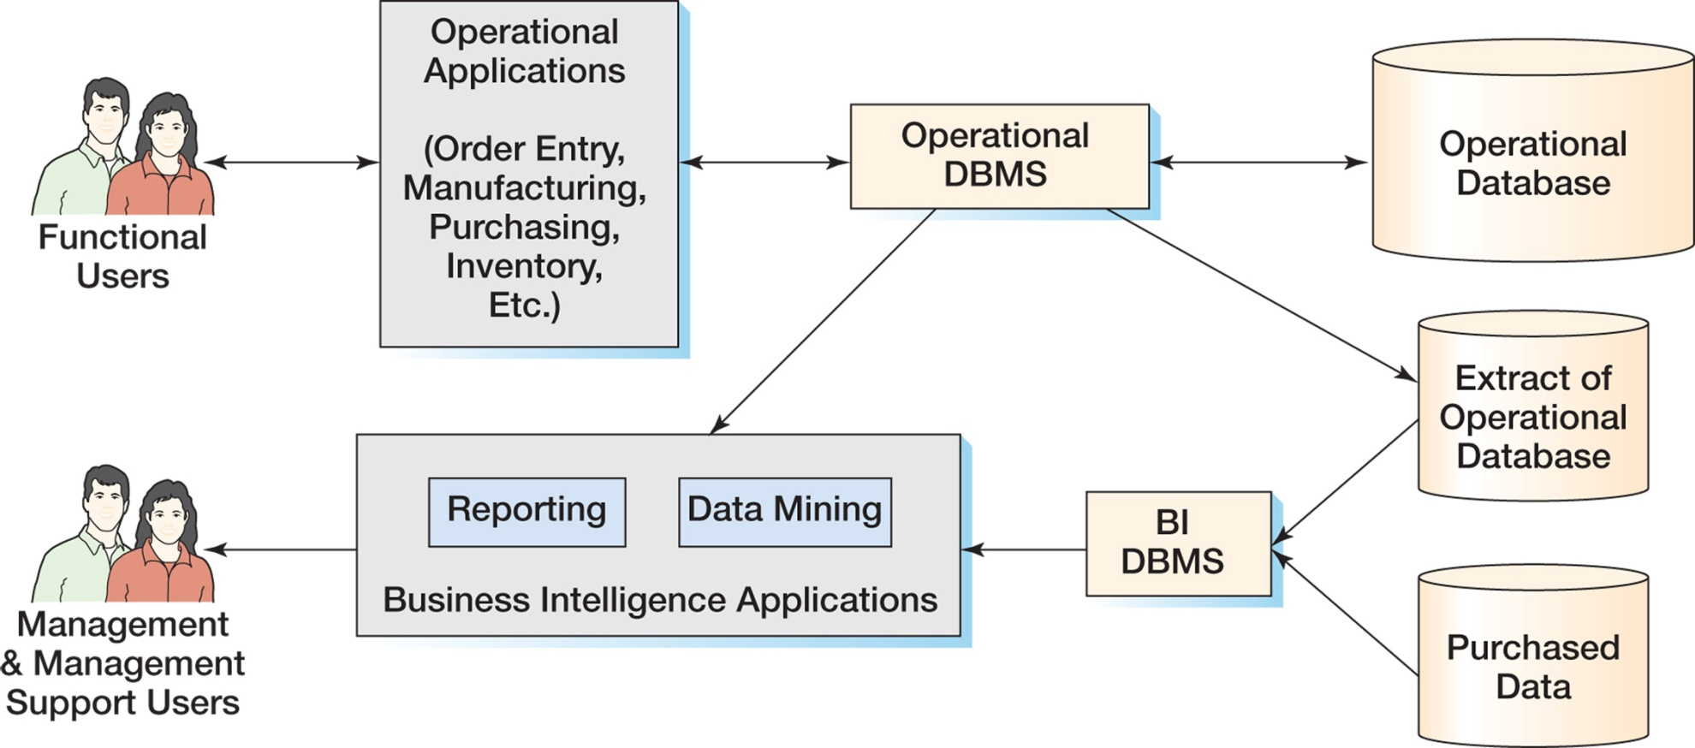
The Relationship of Operational and BI Systems

Slide 7
Data for BI Systems
BI systems obtain data in three ways:
From the operational database
Read and process data only
DO NOT insert, modify or delete operational data
From extracts from the operational database
Data is in a BI DBMS
May be a different DBMS than the operations DBMS
From data purchased from data vendors

Slide 8
Reporting Applications
Reporting system applications:
Filter
Sort
Group
Make simple calculations
Classify entities
RFM Analysis
Can be performed using standard SQL
Extensions to SQL are sometimes used
OnLine Analytical Processing (OLAP)
Summarize current business status
Compare current business status to past or future
Deal with critical report delivery

Slide 9
Data Mining Applications
Data mining applications are used to:
Perform what-if analysis
Make predictions
Facilitate decision making
Data mining applications use sophisticated statistical and mathematical techniques.
Report delivery is not as critical.

Slide 10
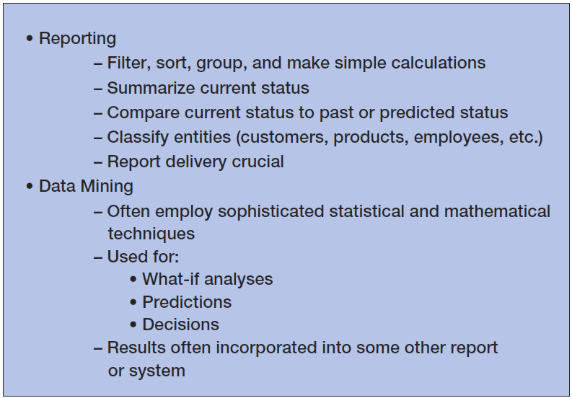
Characteristics of BI Applications

Slide 11
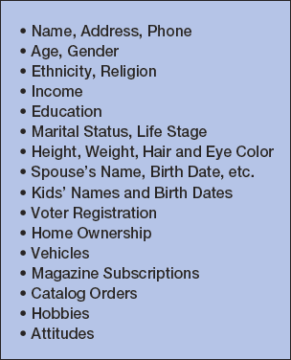
Purchased Data AmeriLINK Sells Data on 230+ Million Americans

Slide 12
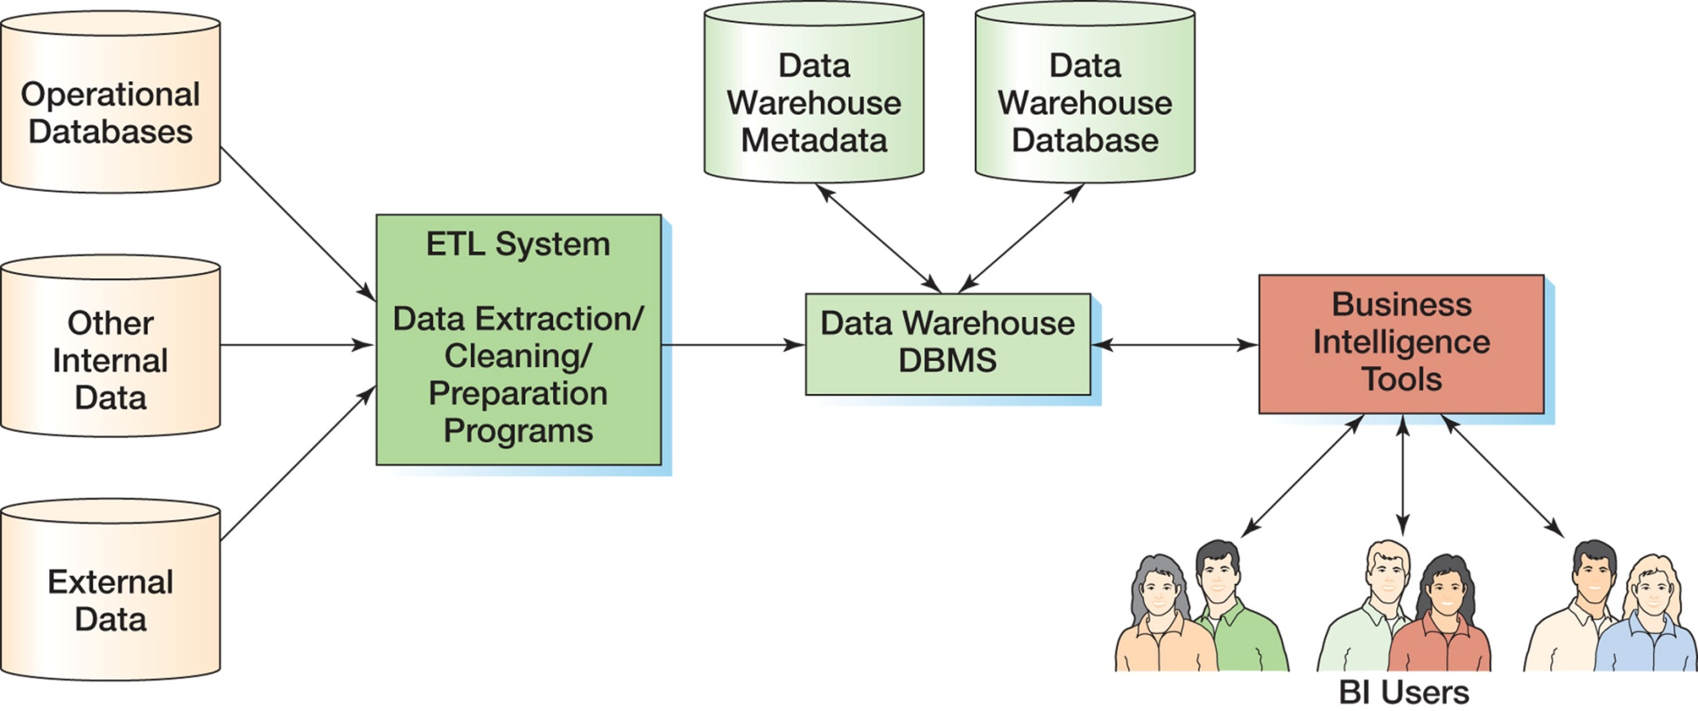
Components of a Data Warehouse

Slide 13
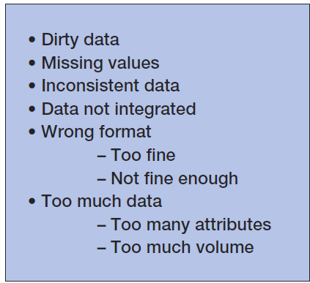
Data Warehouses and Data Marts: Problems with Operational Data

Slide 14
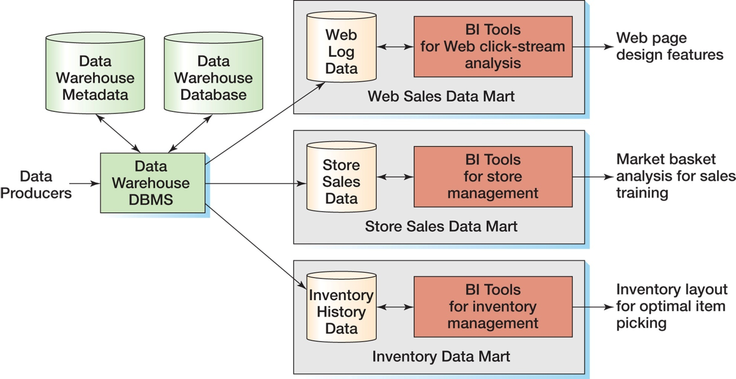
Data Warehouses and Data Marts: Data Warehouse compared to Data Marts

Slide 15
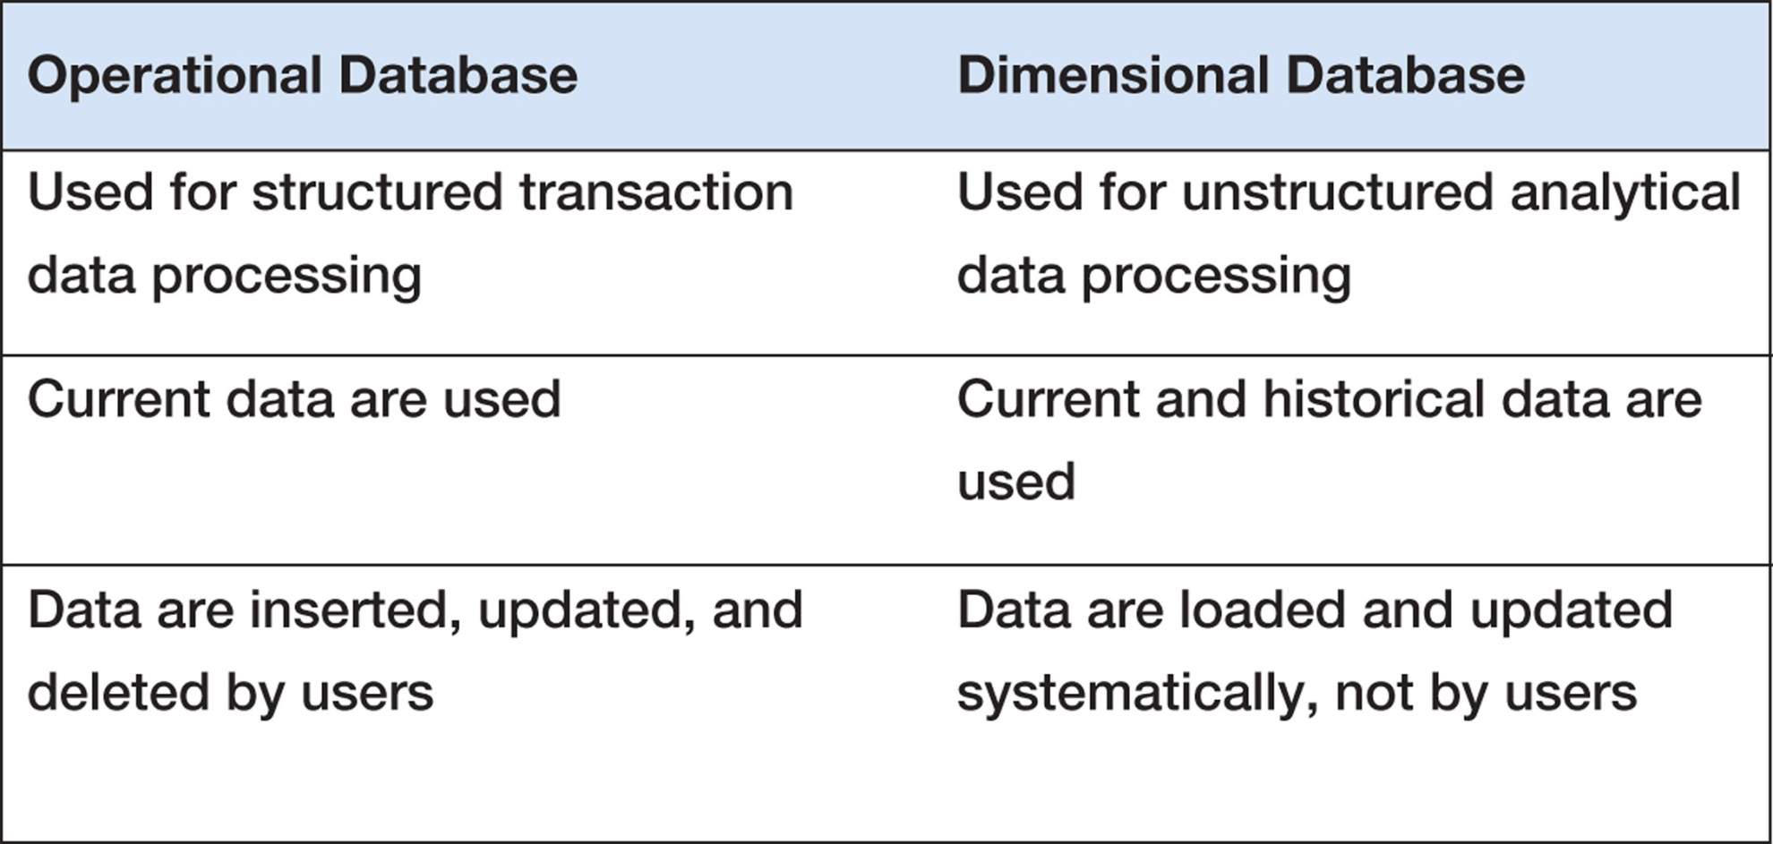
Characteristics of Operational and Dimensional Databases

Slide 16
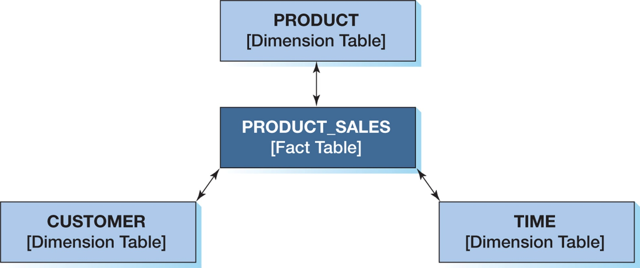
The Star Schema

Slide 17
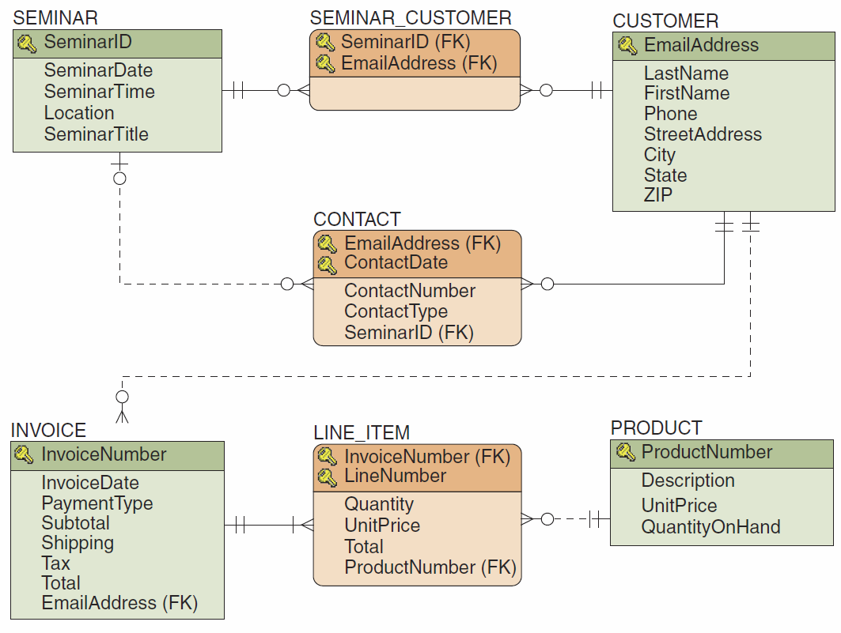
The HSD Database Design

Slide 18
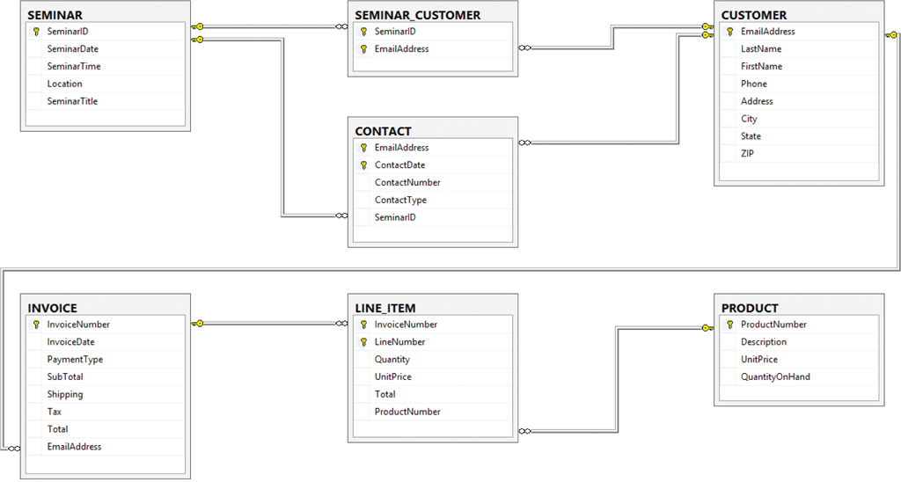
The HSD Database Diagram

Slide 19
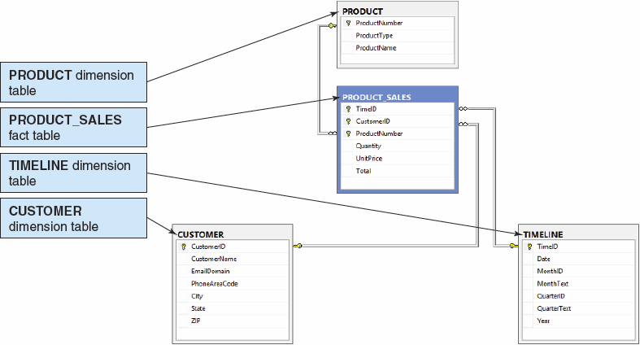
The HSD-DW Star Schema

Slide 20
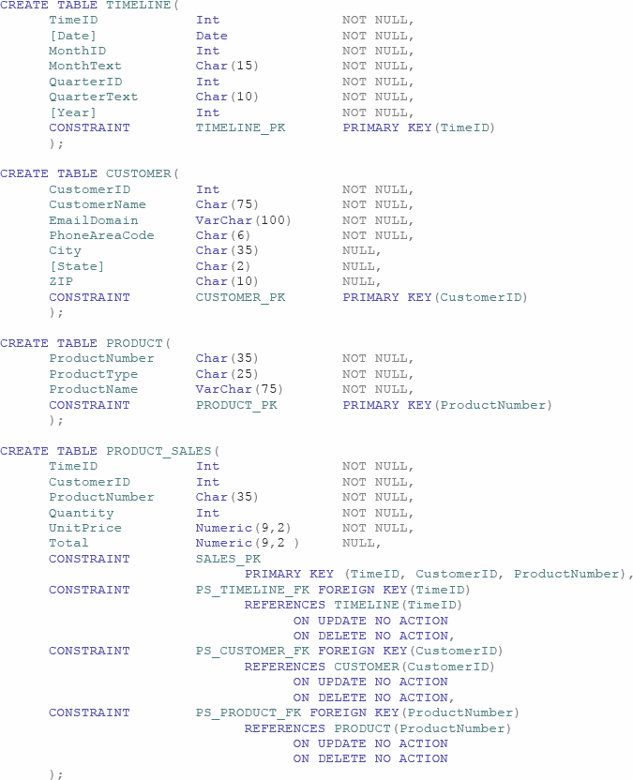
The HSD-DW SQL Statements

Slide 21
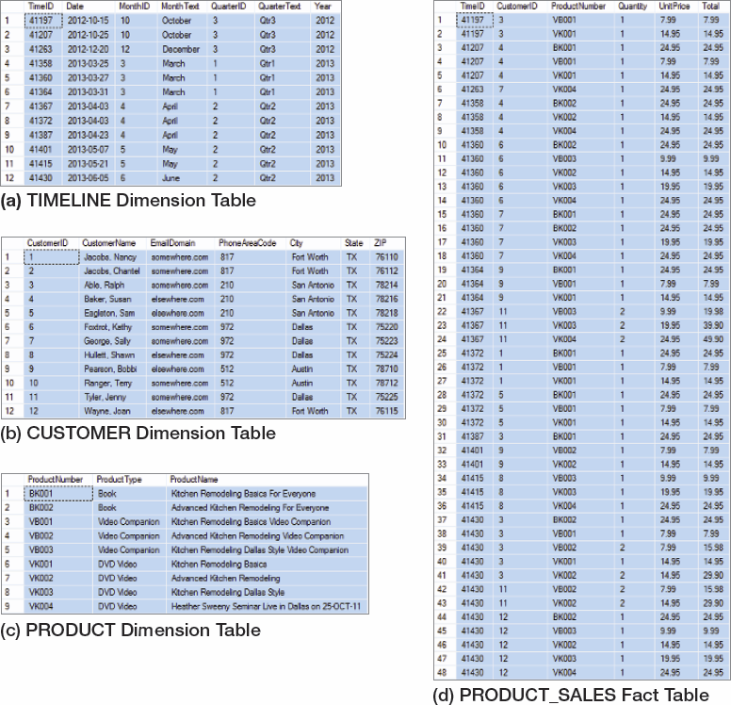
The HSD-DW Table Data

Slide 22
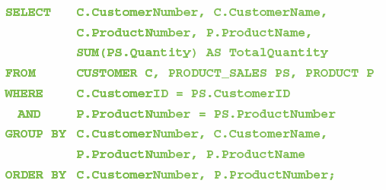
The HSD-DW SQL Query

Slide 23
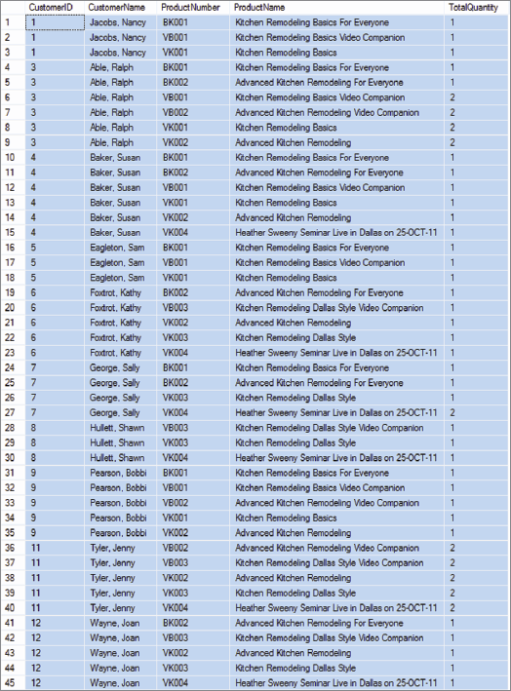
The HSD-DW SQL Query Results

Slide 24
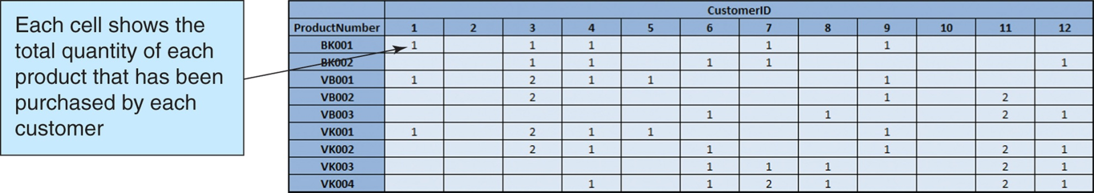
Two-Dimensional Matrix

Slide 25
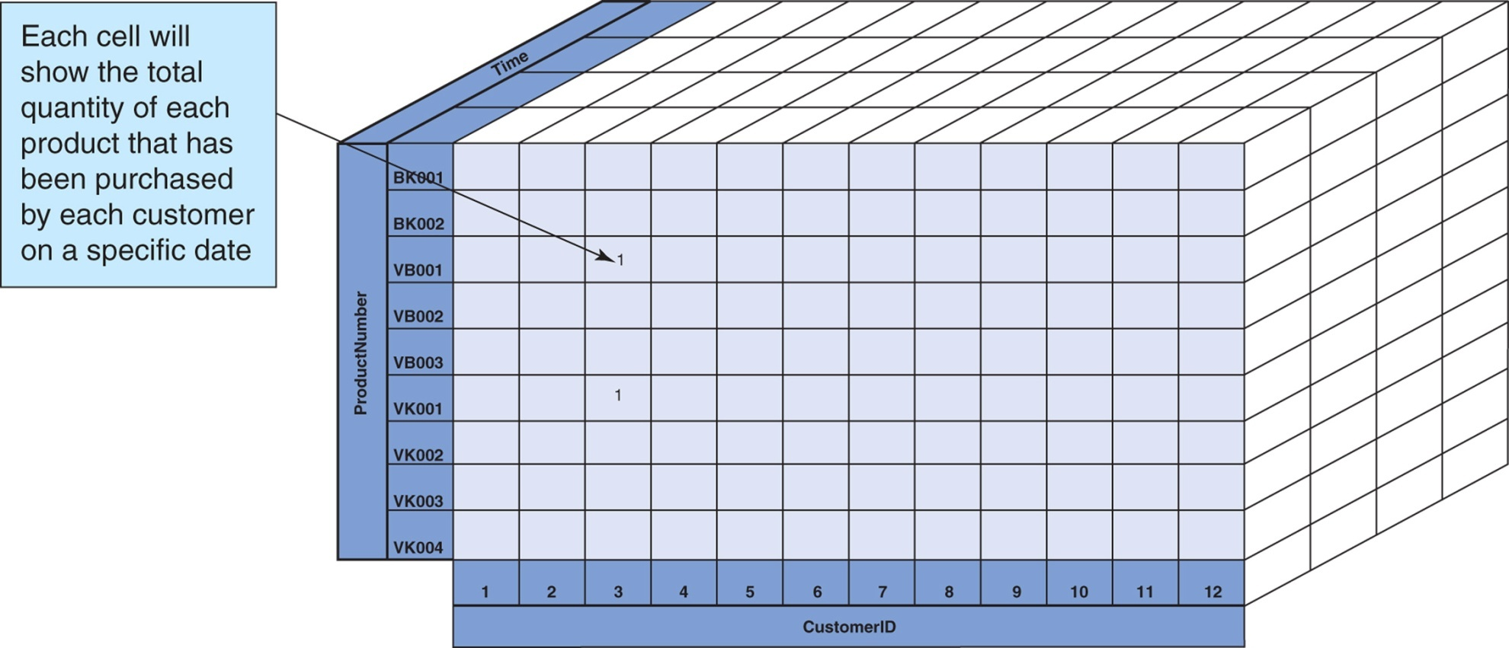
Three-Dimensional Cube

Slide 26
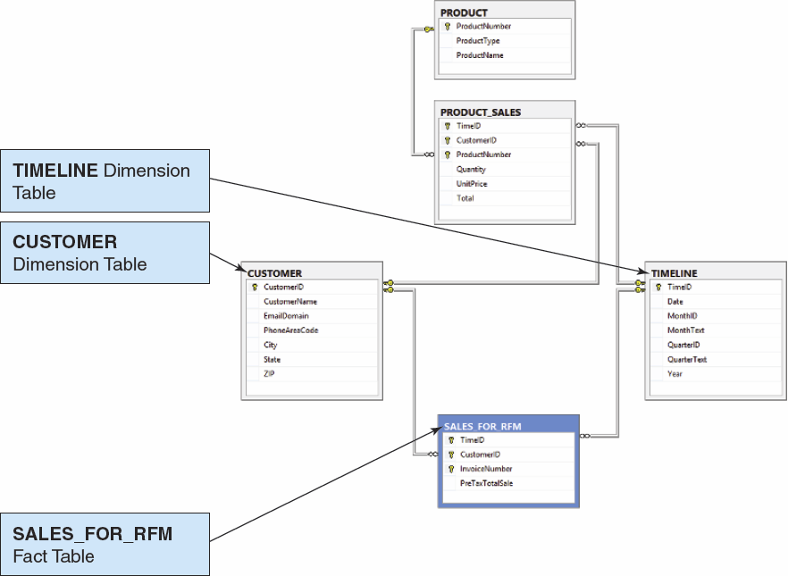
Conformed Dimensions

Slide 27
Reporting Systems: RFM Analysis
RFM Analysis analyzes and ranks customers according to purchasing patterns
R = recent (most recent order)
F = frequent (how often an order is made)
M = money (dollar amount of orders)
Customers are sorted into five groups, each containing 20% of the customers.
Each group is given a numerical value:
1 = top 20%
2, 3, 4 = each 20% in between top and bottom 20%
5 = bottom 20%

Slide 28
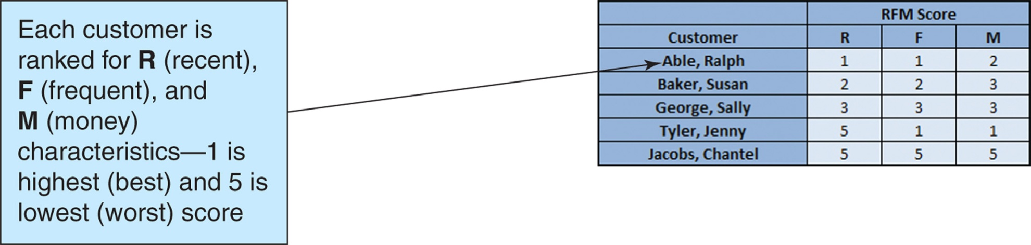
Reporting Systems: RFM Analysis

Slide 29
Reporting Systems: OnLine Analytical Processing [OLAP]
An OLAP report has measures and dimensions:
Measure—a data item of interest
Dimension—a characteristic of a measure
OLAP cube—a presentation of a measure with associated dimensions.
An OLAP cube can have any number of axes.
The terms OLAP cube and OLAP report are synonymous.
OLAP allows drill-down—a further division of the data into more detail.

Slide 30
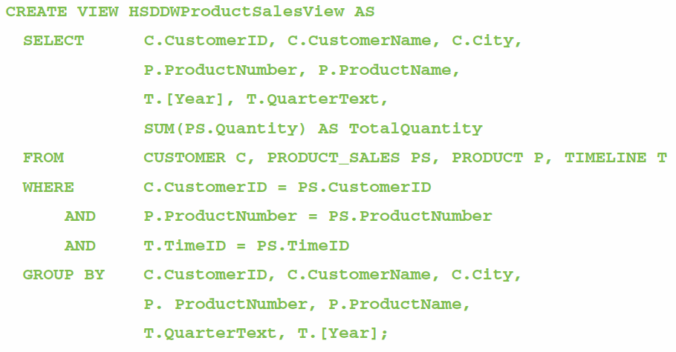
Reporting Systems: OLAP Reports I

Slide 31
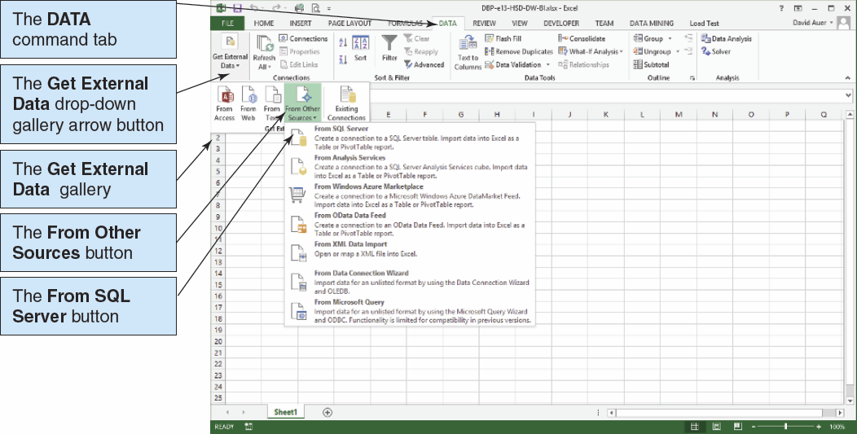
Reporting Systems: OLAP Reports II

Slide 32
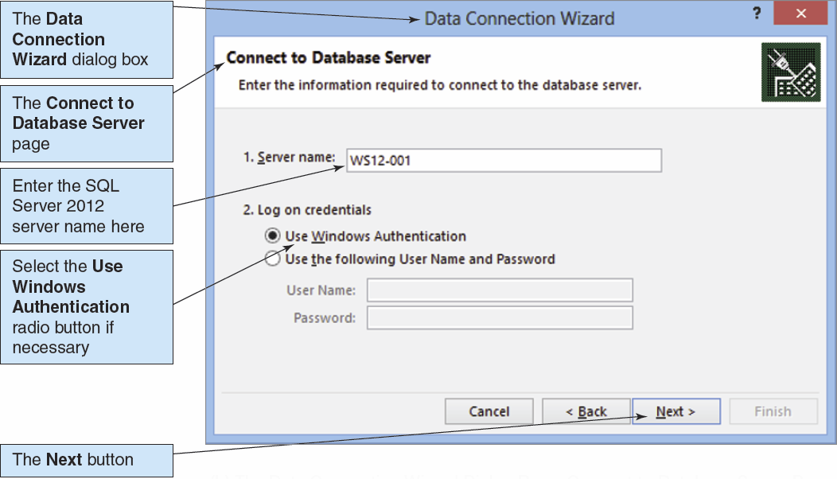
Reporting Systems: OLAP Reports III

Slide 33
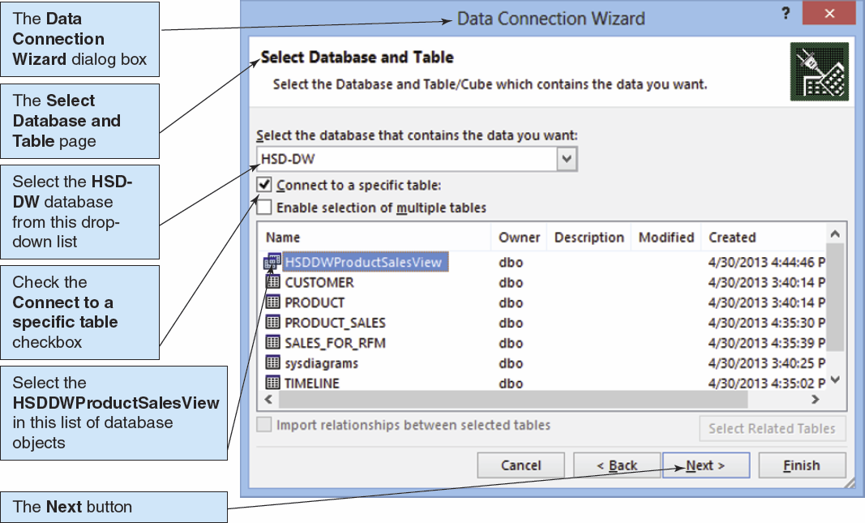
Reporting Systems: OLAP Reports IV

Slide 34
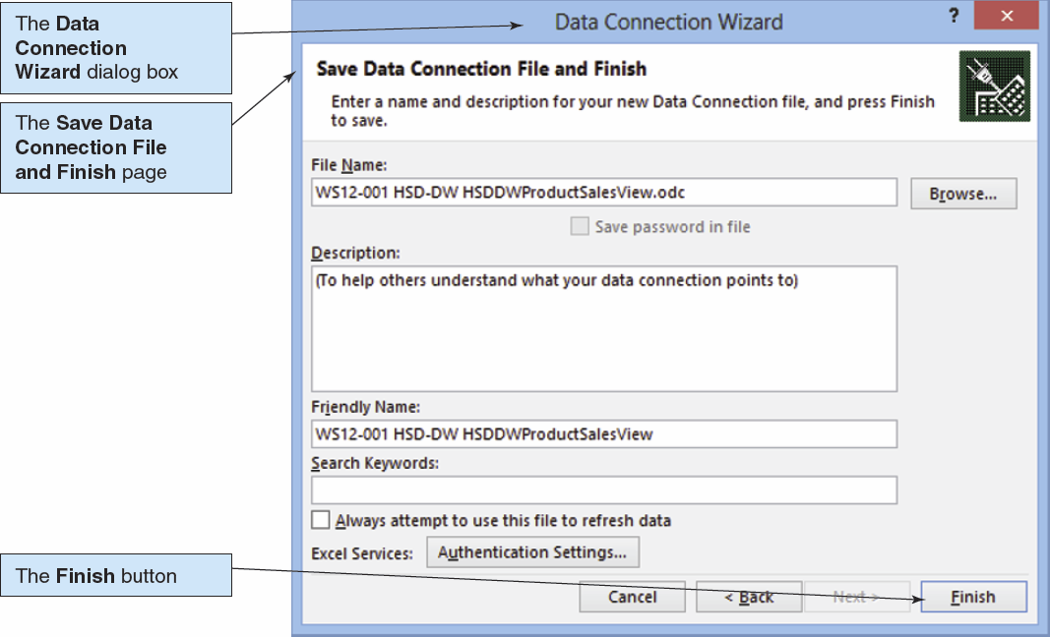
Reporting Systems: OLAP Reports V

Slide 35
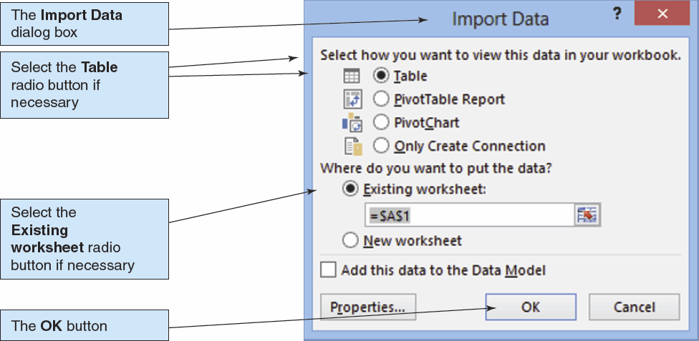
Reporting Systems: OLAP Reports VI

Slide 36
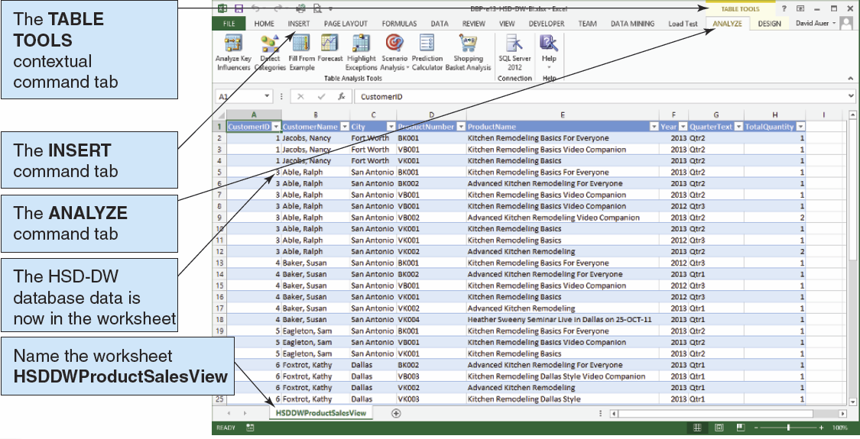
Reporting Systems: OLAP Reports VII

Slide 37
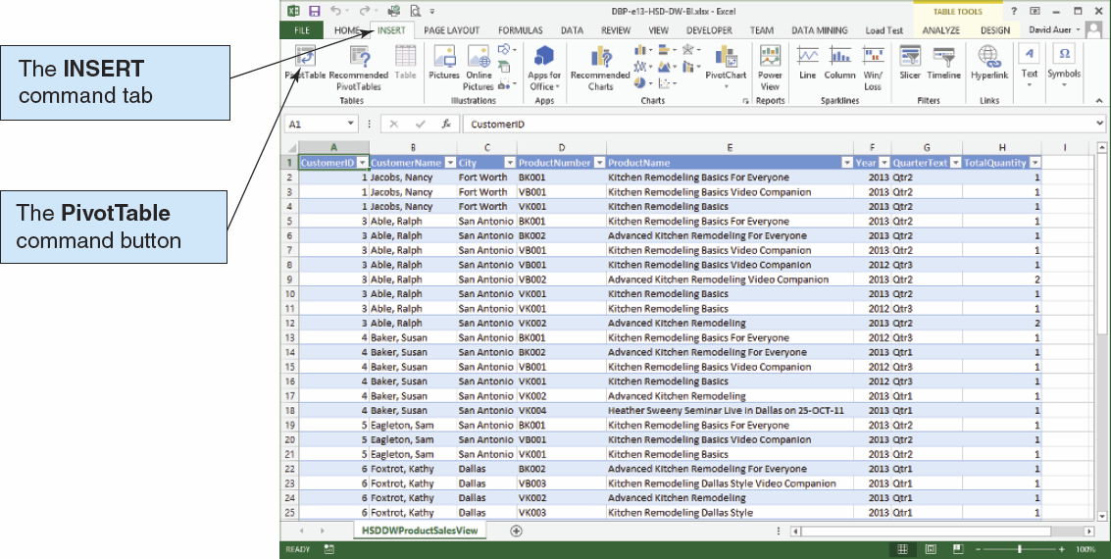
Reporting Systems: OLAP Reports VIII

Slide 38
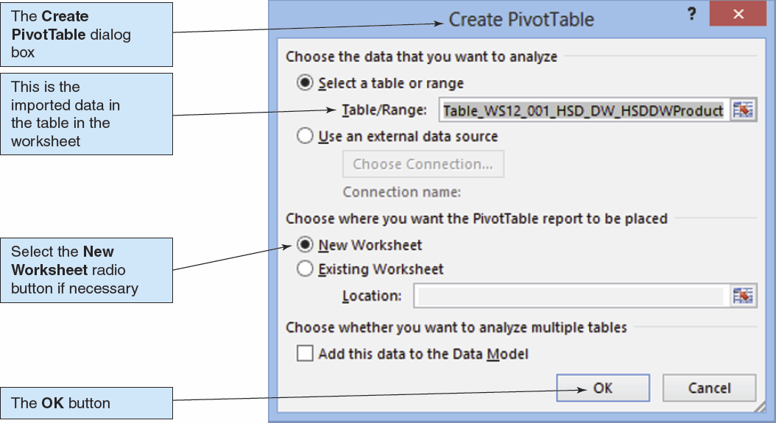
Reporting Systems: OLAP Reports IX

Slide 39
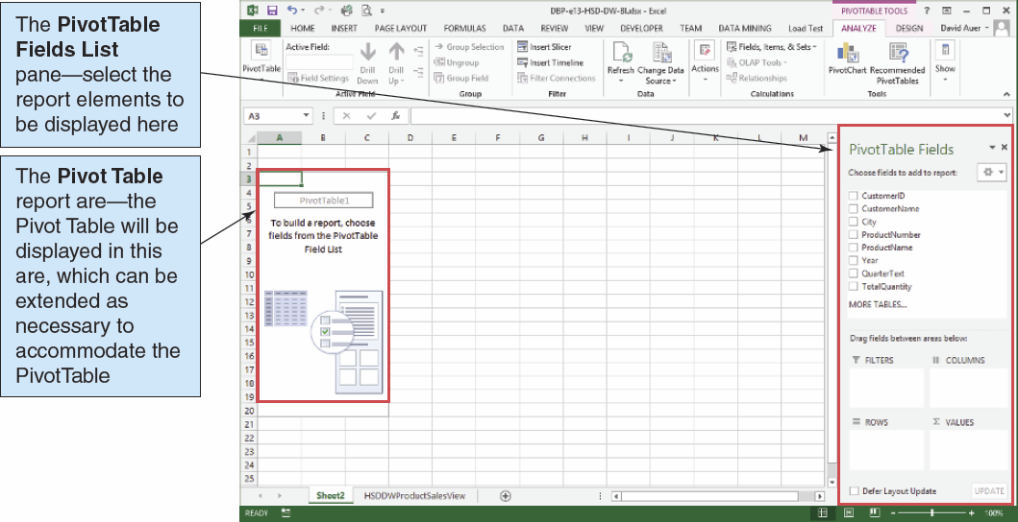
Reporting Systems: OLAP Reports X

Slide 40
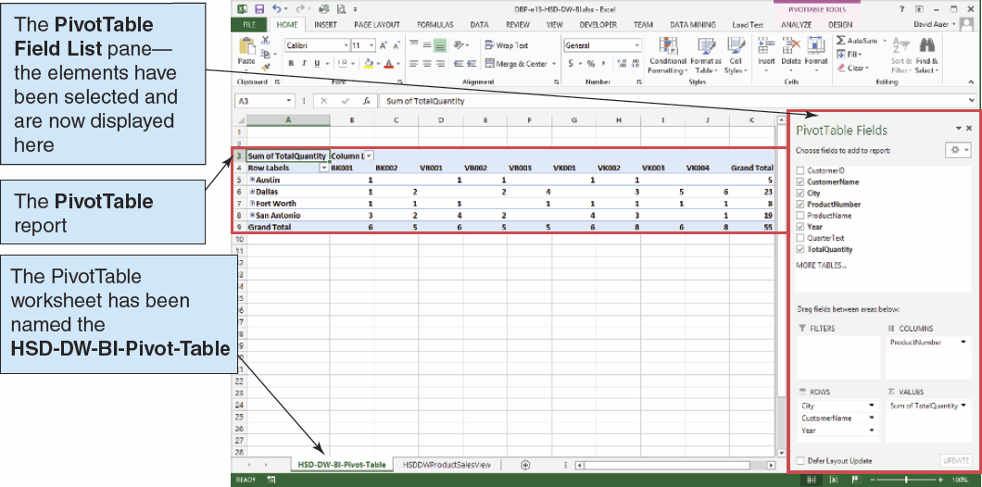
Reporting Systems: OLAP Reports XI

Slide 41
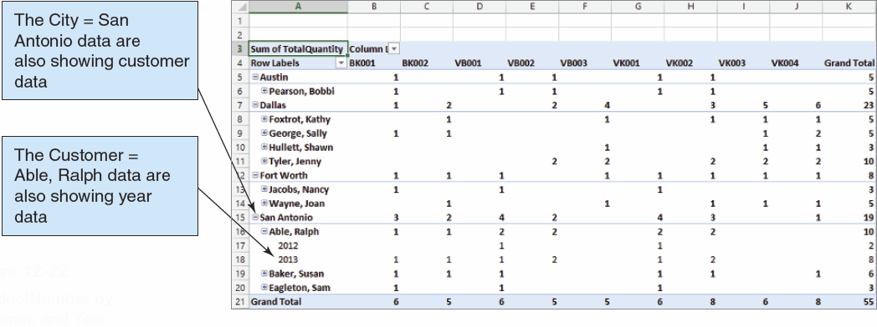
Reporting Systems: OLAP Drill Down I

Slide 42
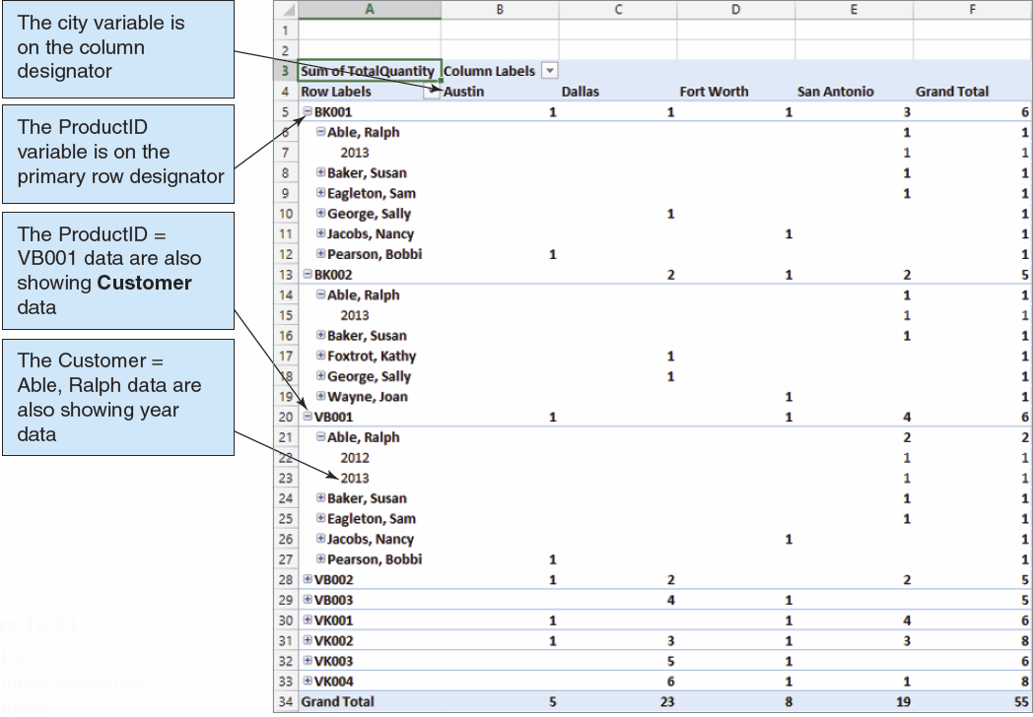
Reporting Systems: OLAP Drill Down II

Slide 43
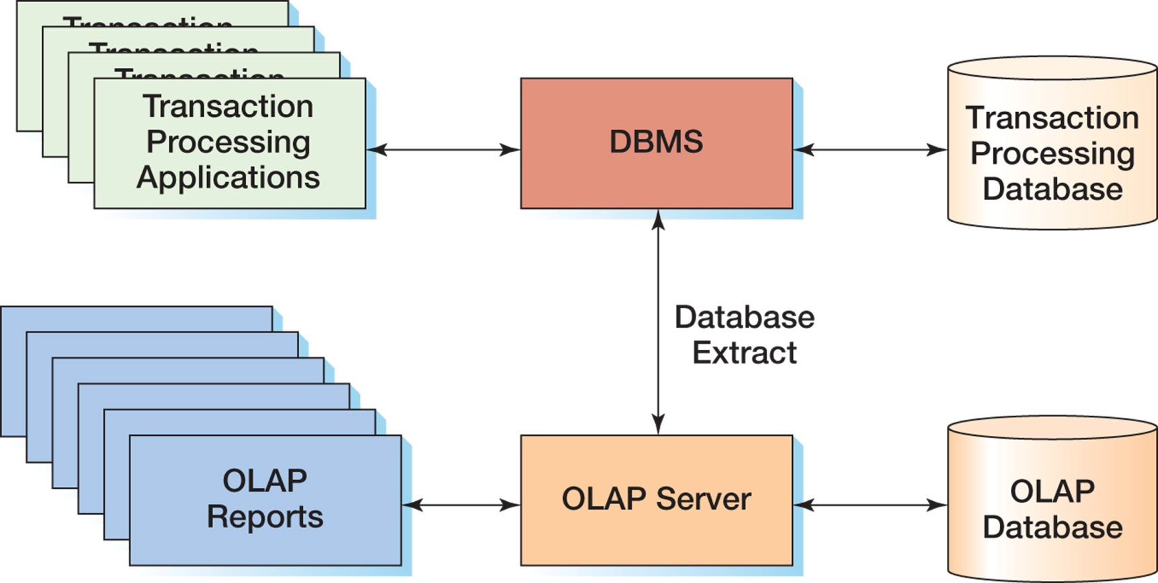
Reporting Systems: OLAP Servers and OLAP Databases

Slide 44
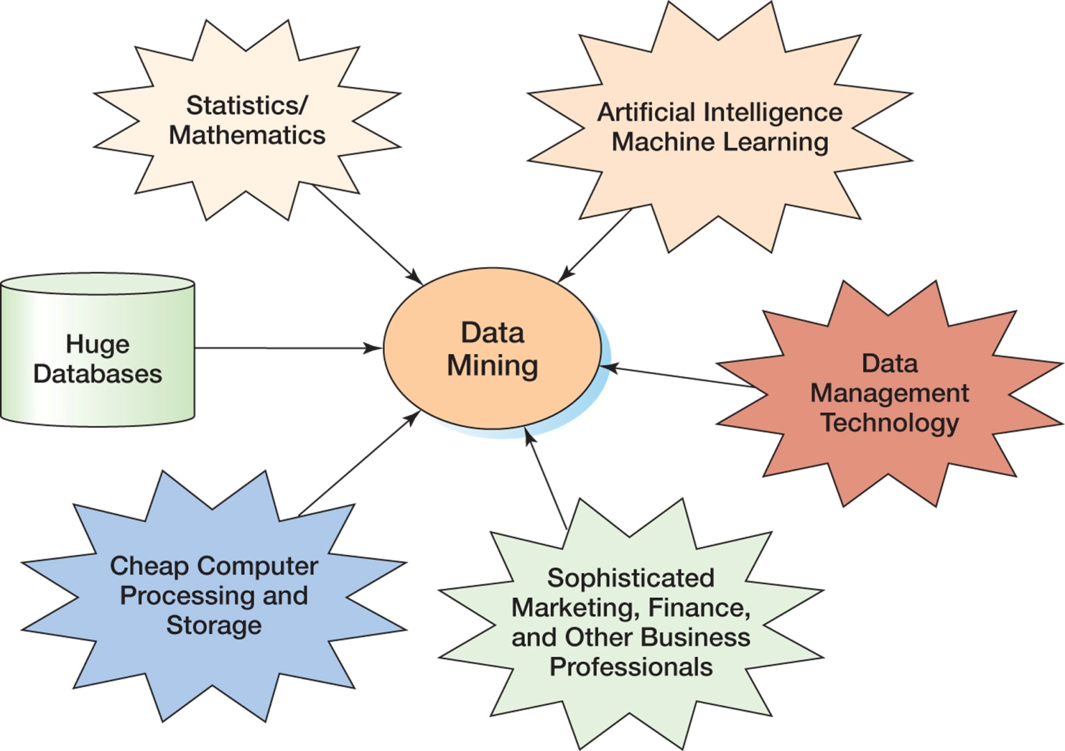
Data Mining Applications: The Convergence of the Disciplines

Slide 45
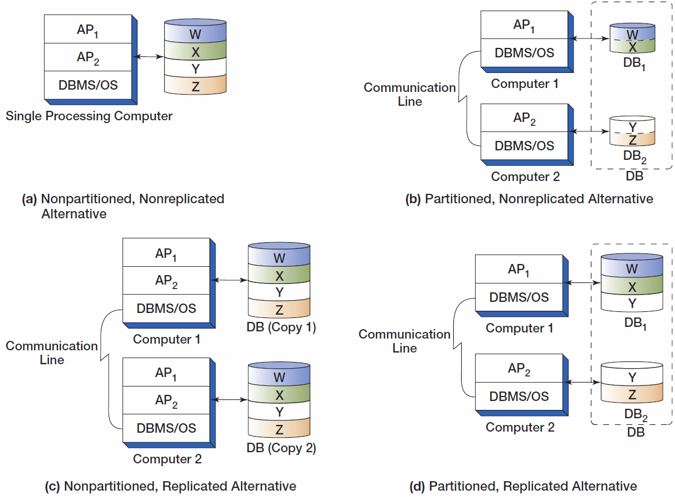
Types of Distributed Databases

Slide 46
Object-Oriented Database I
Object-oriented programming (OOP) is a technique for designing and writing computer programs.
Objects are data structures that have:
Methods—computer programs that perform some task
Properties—data items particular to an object.

Slide 47
Object-Oriented Database II
Storing the values of properties of an object is called object persistence.
Many different techniques have been used for object persistence.
One of them is to use some variation of database technology.

Slide 48
Object-Oriented Database III
Special-purpose DBMS products for storing object data are called object-oriented DBMSs (OODBMSs)
Never achieved commercial success.
Billions of bytes of data were already stored in relational DBMS format
No organization wanted to convert their data to OODBMS format to be able to use an OODBMS.

Slide 49
Object-Oriented Database IV
The need for object persistence did not disappear.
Some vendors, most notably Oracle, added features and functions to their relational database DBMS products to create object-relational databases.
DBMS products for storing object data are called object-oriented DBMSs (OODBMSs).

Slide 50
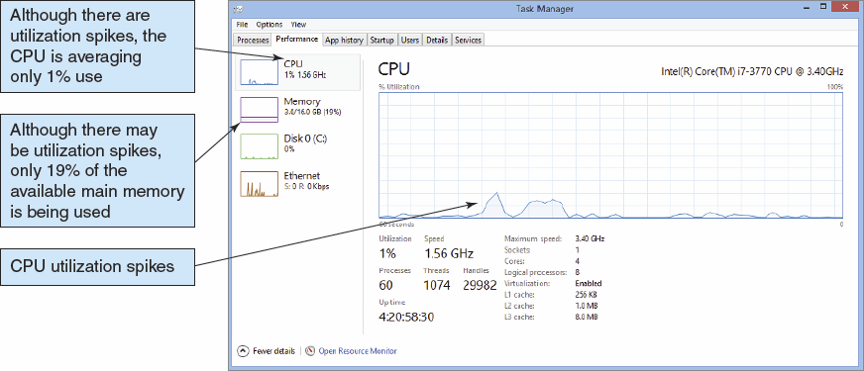
Virtualization Underutilization of Computer Resources

Slide 51
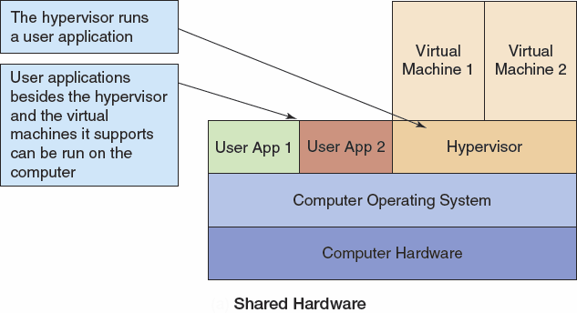
Virtualization The Virtual Machine Environment I

Slide 52
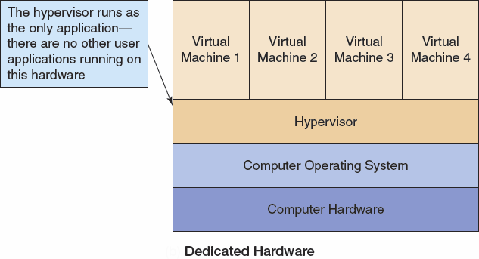
Virtualization The Virtual Machine Environment II

Slide 53
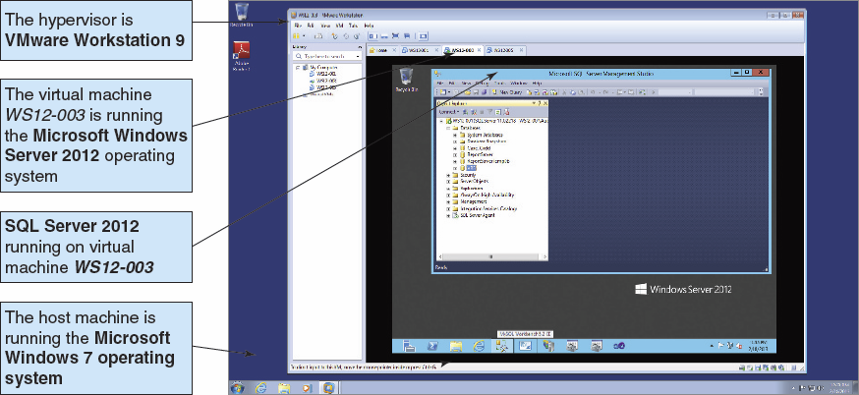
Virtualization The Virtual Machine Environment III

Slide 54
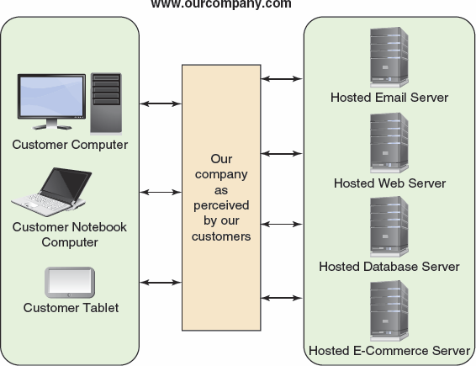
Cloud Computing The Cloud Computing Environment

Slide 55
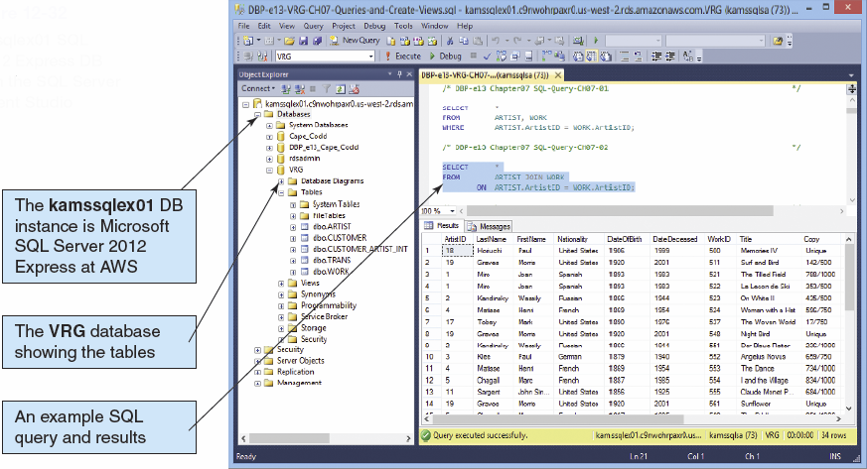
Cloud Computing Microsoft SQL Server 2012 Express in the Cloud

Slide 56
The NoSQL Movement I
The NoSQL movement, better described as the Not only SQL movement, is a movement to using non-relational databases.
These databases are often described as structured storage.

Slide 57
The NoSQL Movement II
One implementation is as a distributed, replicated database that is described in this chapter.
Example: Apache Cassandra
Used for Facebook
Used for Twitter

Slide 58
The NoSQL Movement III
Another implementation is based on XML document structures as described in this Chapter.
Example: dbXML
XML database typically support:
W3C XQuery standard
W3C XPath standard

Slide 59
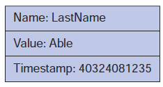
Generalized Structured Storage: A Column

Slide 60
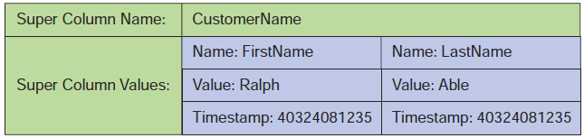
Generalized Structured Storage: A Super Column

Slide 61
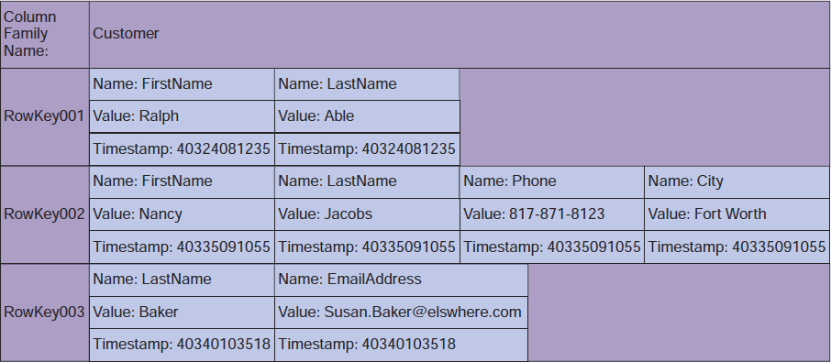
Generalized Structured Storage: A Column Family

Slide 62
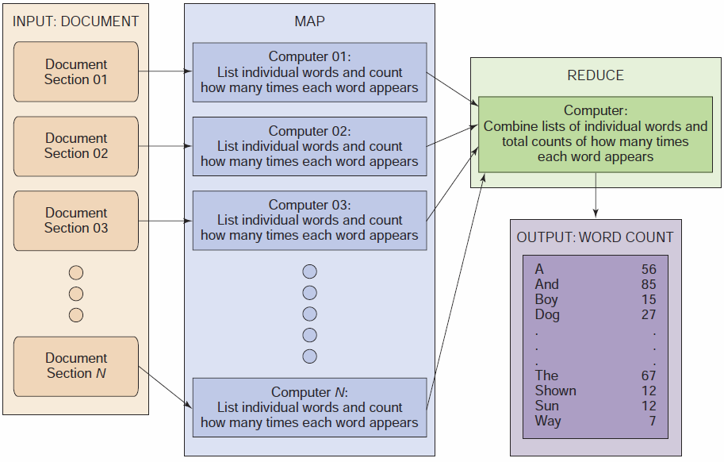
The MapReduce Process

Slide 63
HADOOP
Hadoop Distributed File System (HDFS) – provides standard file services to clustered servers so their file systems can function as one distributed file system.
The Hadoop family includes a full set of applications including:
Hbase – A nonrelational data store.
Pig – A query language.

Slide 64
David Kroenke and David Auer Database Processing Fundamentals, Design, and Implementation (13th Edition)
End of Presentation:
Chapter Twelve

Slide 65
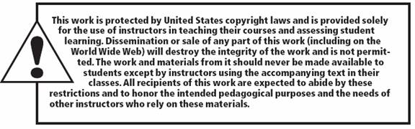
All rights reserved. No part of this publication may be reproduced, stored in a retrieval system, or transmitted, in any form or by any means, electronic, mechanical, photocopying, recording, or otherwise, without the prior written permission of the publisher. Printed in the United States of America.

